Slide 1



KONSTANTINOS MAVRIDIS
LAKE
KERKINI
WWW.REALLYGREATSITE.COM

Slide 2
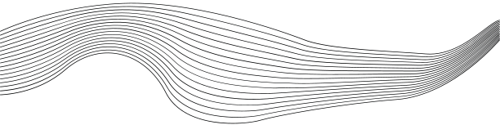
CONTENT
01
ABOUT THE LAKE
02
THE FLORA OF THE LAKE
03
THE FAUNA OF THE LAKE
04
HISTORY
05
PLACES TO GO
06
ABOUT THE PROJECT

Slide 3
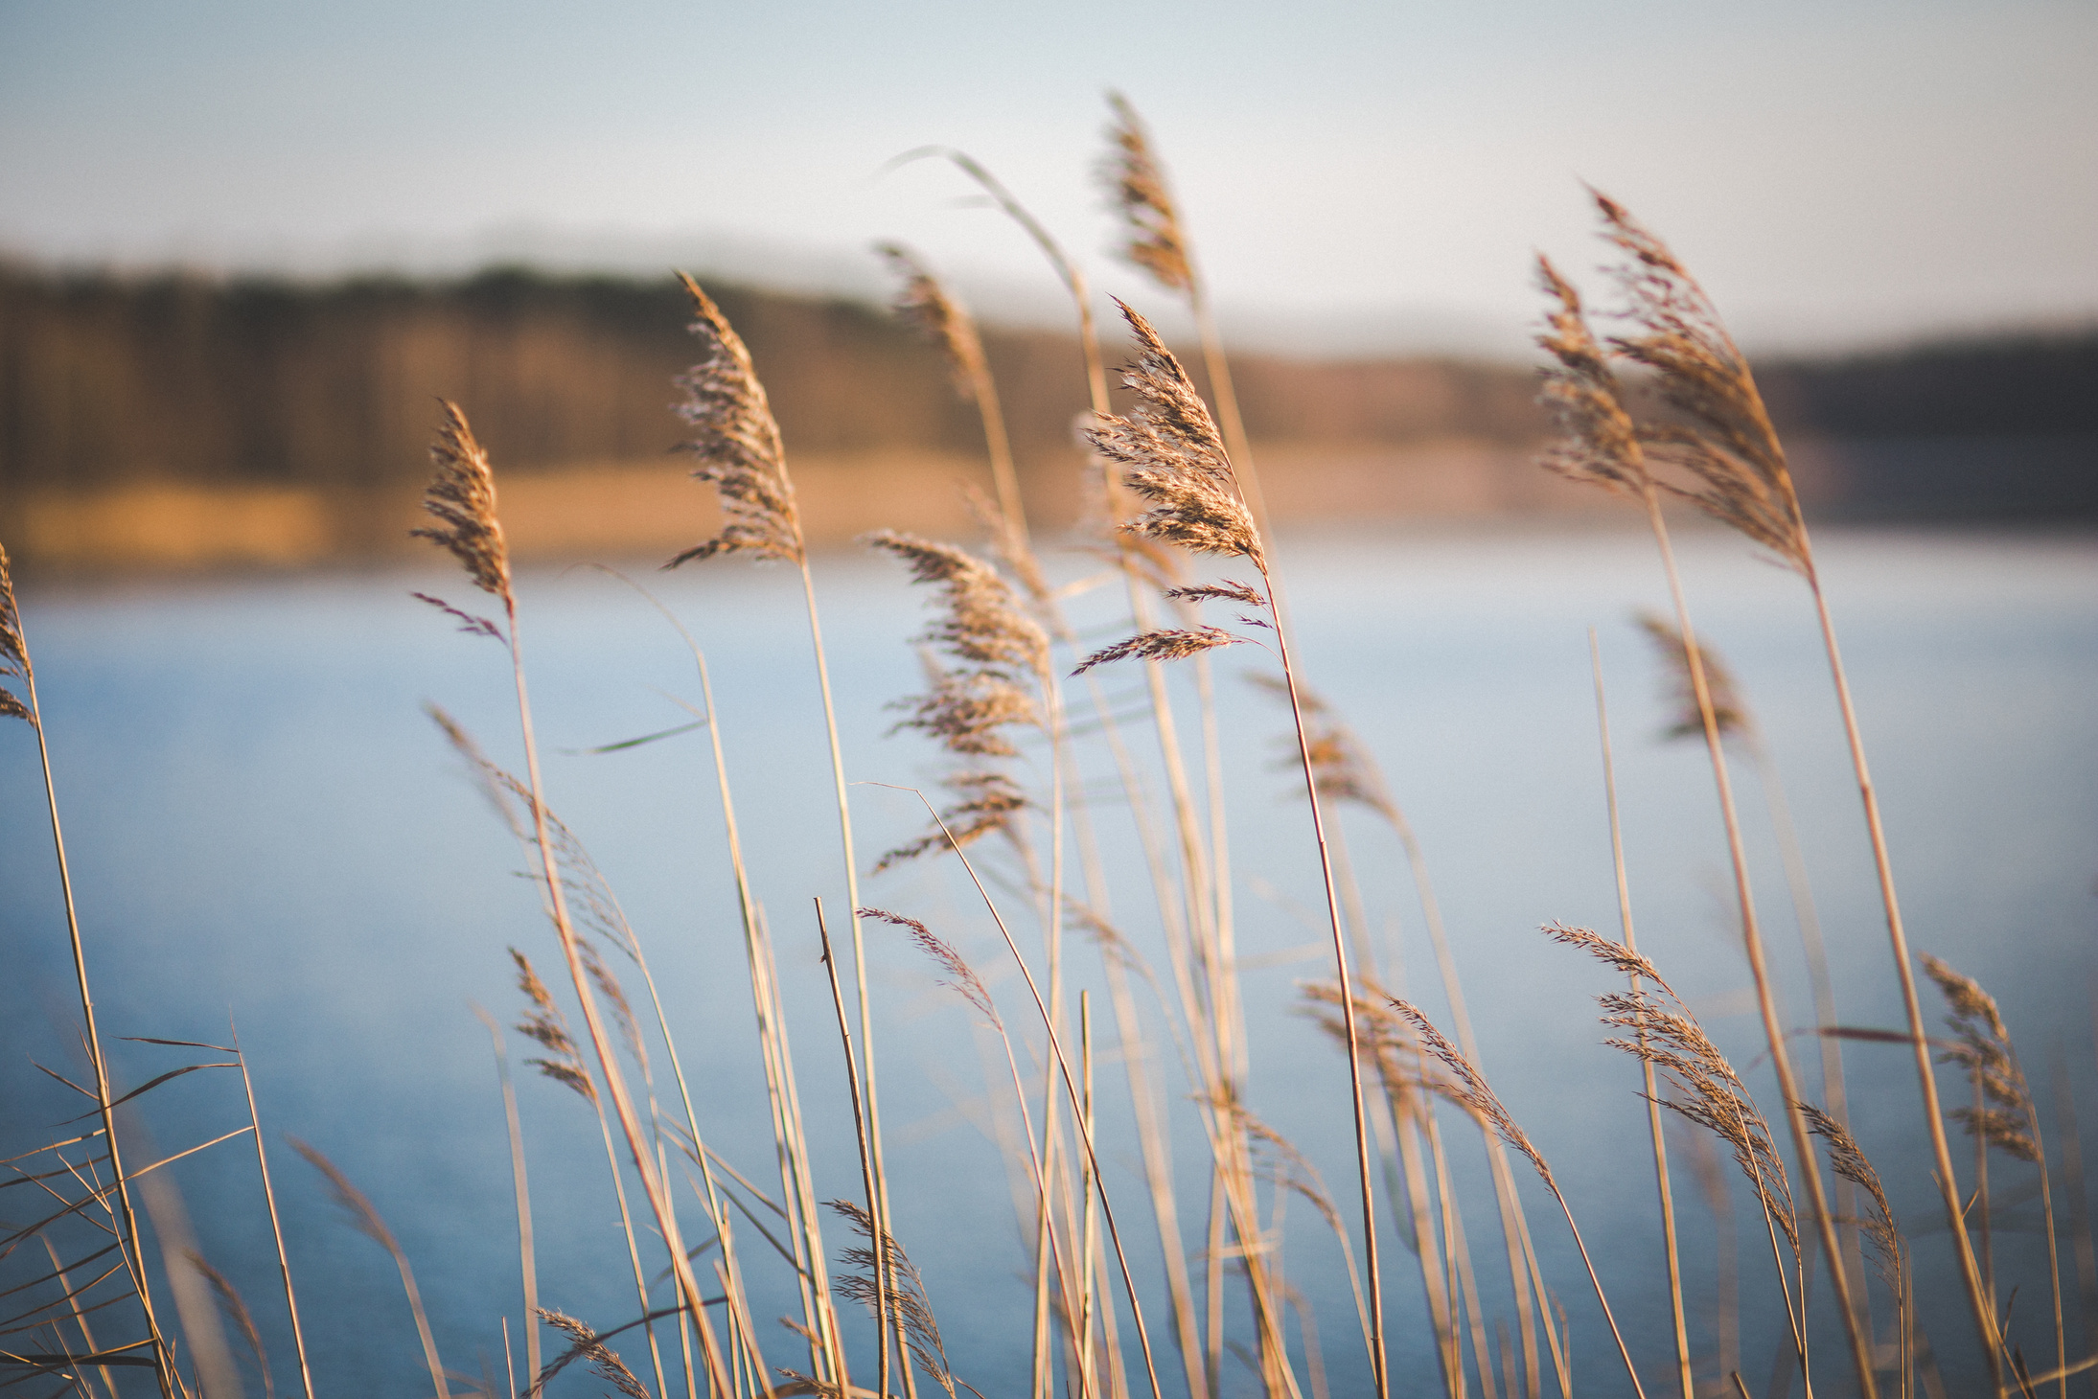
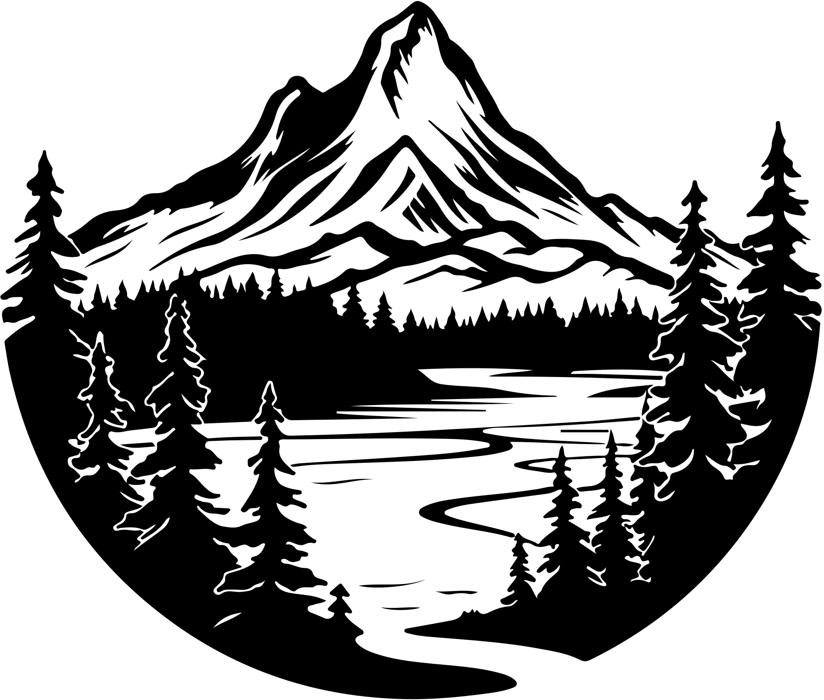

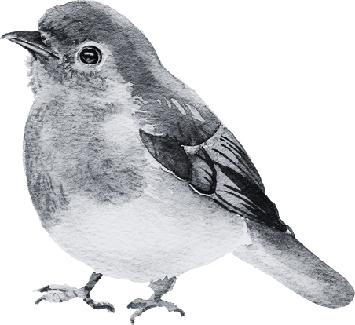
ABOUT THE LAKE
Lake Kerkini (Greek: Λίμνη Κερκίνη – Limni Kerkini) is an artificial reservoir in Central Macedonia, Greece that was created in 1932, and then redeveloped in 1980, on the site of what was previously an extremely extensive marshland.
Lake Kerkini is now one of the premier birdwatching sites in Greece, as it is situated along the migratory flyway for birds en route to the Aegean Sea, the Balkan region, the Black Sea, the Hungarian steppes and beyond.

Slide 4
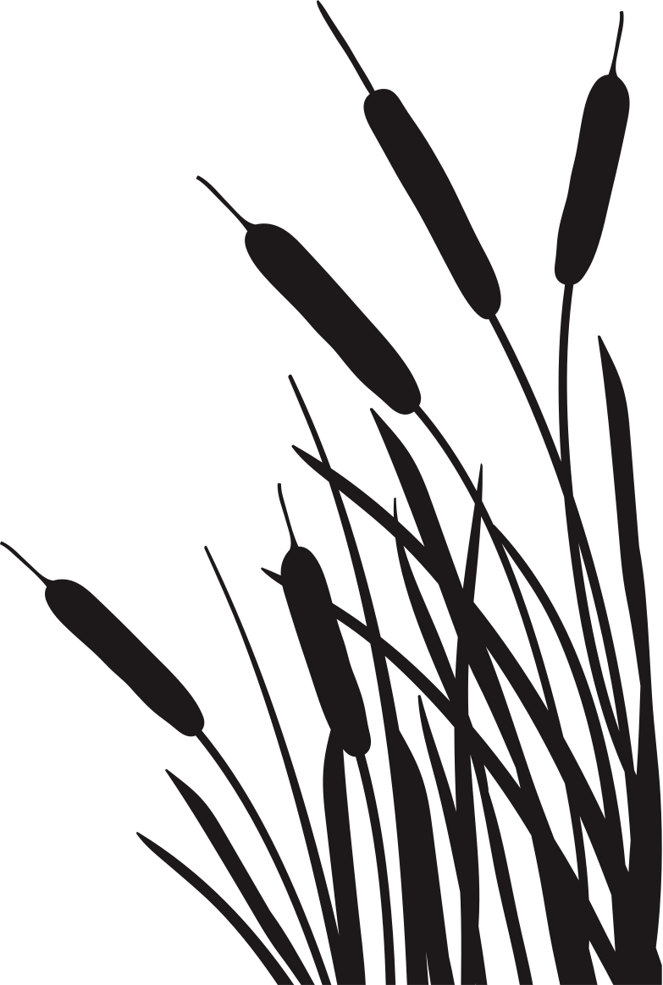


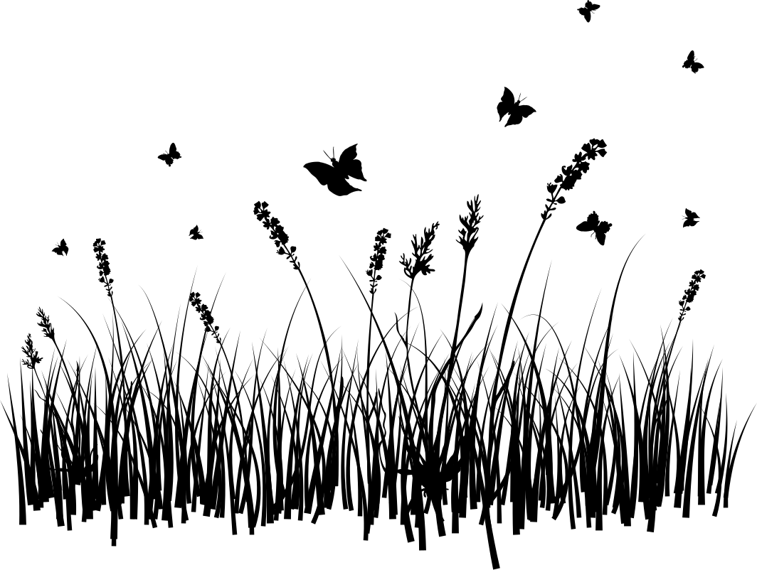
THE FLORA OF THE LAKE
Water lilies
Reeds
Wet Meadows
Nymphaeaceae is a family of flowering plants, commonly called water lilies. They live as rhizomatous aquatic herbs in temperate and tropical climates around the world.
Reed is a common name for several tall, grass-like plants of wetlands.
A wet meadow is a type of wetland with soils that are saturated for part or all of the growing season which prevents the growth of trees and brush. Debate exists whether a wet meadow is a type of marsh or a completely separate type of wetland.[1] Wet prairies and wet savannas are hydrologically similar.

Slide 5




THE FAUNA OF THE LAKE
300 bird species
Μammals
Water buffalo
More than 300 bird species have been observed in the Lake Kerkini National Park. 137 of these species nest, 134 overwinter and 163 use the wetland and the surrounding area as an intermediate resting and foraging stop in their migration routes.
The otter (Lutra lutra) is met in the lake, in channels and ditches. The red fox (Vulpes vulpes), the wildcat (Felis sylvestris), the least weasel (Mustela nivalis)
The area of the lake hosts the largest number of water buffalo in Greece, a species that is under the protection of the Greek state. In the past, water buffalo could be found in most of wetlands of Macedonia, Thrace and Thessaly but in the last 50 years they have been restricted to only a few wetlands in the country.

Slide 6


HISTORY
Before 1932, there were irregular marsh lakes on Strymon, one of them called "Podkova" (in Bulgarian and Slavic Macedonian "Podkova" meaning "Horseshoe", found in Ottoman Turkish records: ݒودقوه كولي Podkova Gölü.).
Kerkini lake was created by making embankments on the eastern and western sides of the river and by a dam constructed near the village of Lithotopos, which started functioning in 1932.
As time went by, the lake's capacity was reduced due to silt deposited by Strymon river. So the raising of the embankments and the construction of a new dam was necessary, which started operating in 1982.

Slide 7

01
02
03
04
MONASTERY OF SAINT JOHN THE BAPTIST
ERODIOS HOTEL
EVORA RESTAURANT
ARCHEOLOGICAL MUSEUMS
`
You can stay in this hotel
You can eat there
You can visit it
You can pray there

Slide 8


ABOUT THE PROJECT
This project is created for my homework in the cladd of Geograophy

Slide 9

THANK'S FOR WATCHING
KONSTANTINOS MAVRIDIS

